Slide 1

My Recipe Book
Gavin Hanna
15/12/2018

Slide 2
My recipe book
BACKGROUND
Top recipe websites get between 2 and 25 million unique visitors per month. (ebizimba.com, 2018)
The word “food” is searched for over 800,000 times per month on Google. (searchvolume.io, 2018)
For social networks, Facebook alone has over 2 billion registered users. (statista.com, 2018)

Slide 3
My recipe book
CONCLUSION & AIM
Produce a recipe based social network
Create a PWA (Progressive Web App) to enable launching from mobile home screens.

Slide 4
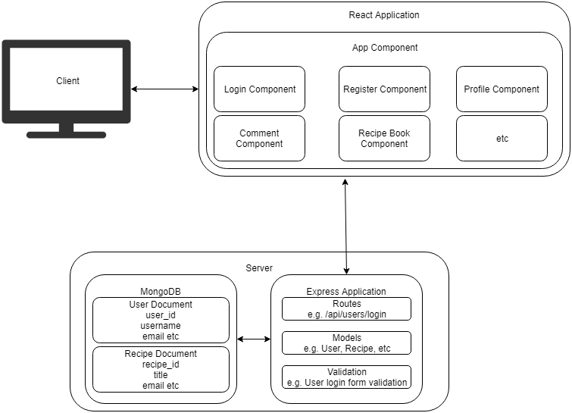
My recipe book

Slide 5
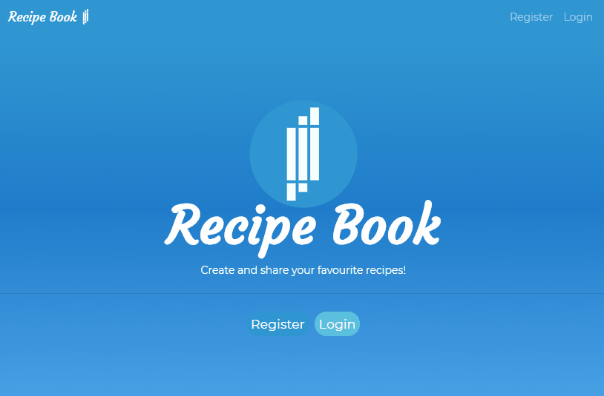
My recipe book
User Interface – Landing Page

Slide 6
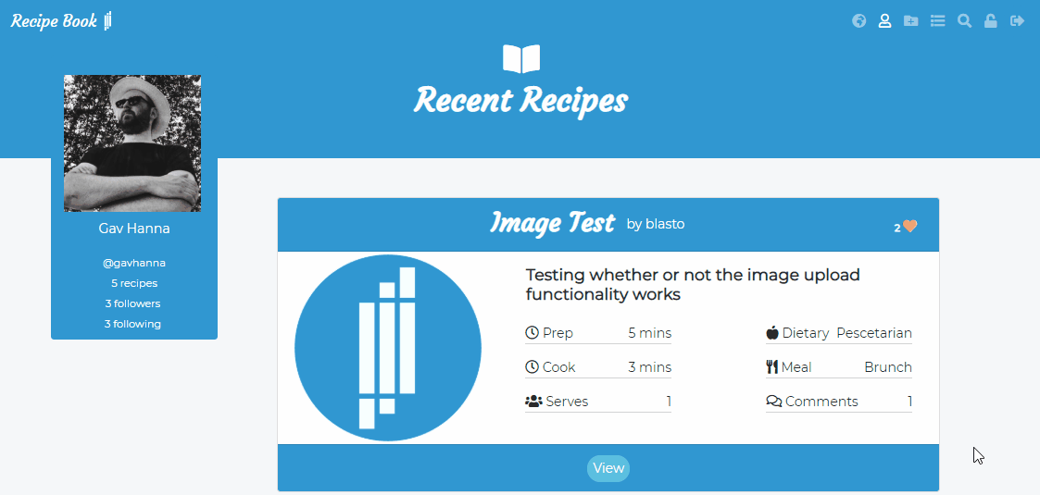
My recipe book
User Interface – “Feed” Page

Slide 7
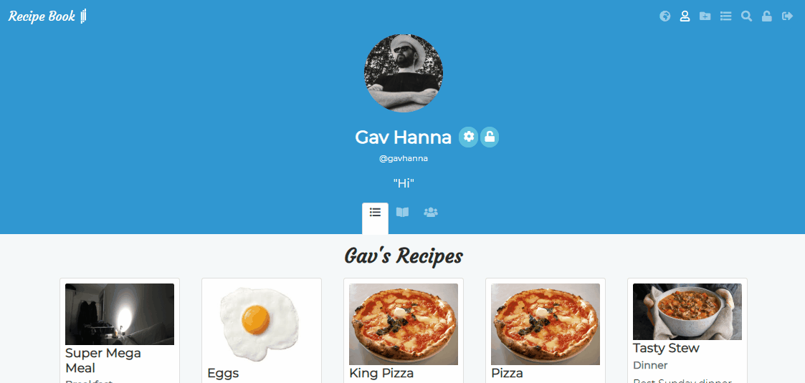
My recipe book
User Interface – User Profile

Slide 8
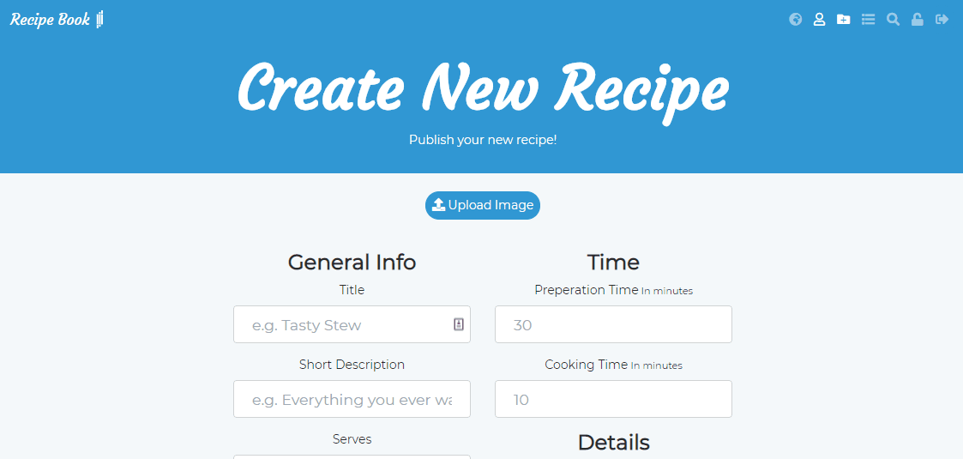
My recipe book
User Interface – Create Recipe Page

Slide 9
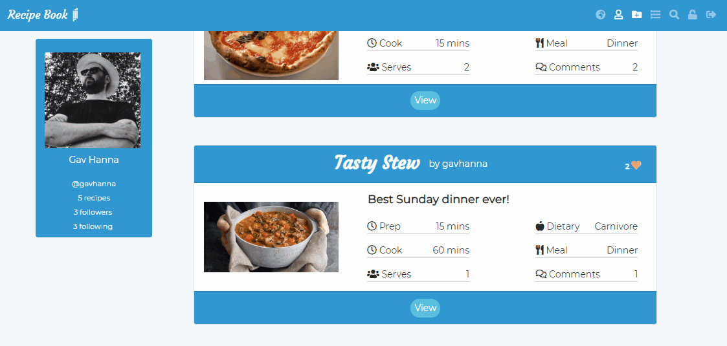
My recipe book
User Interface – Recipe Page

Slide 10
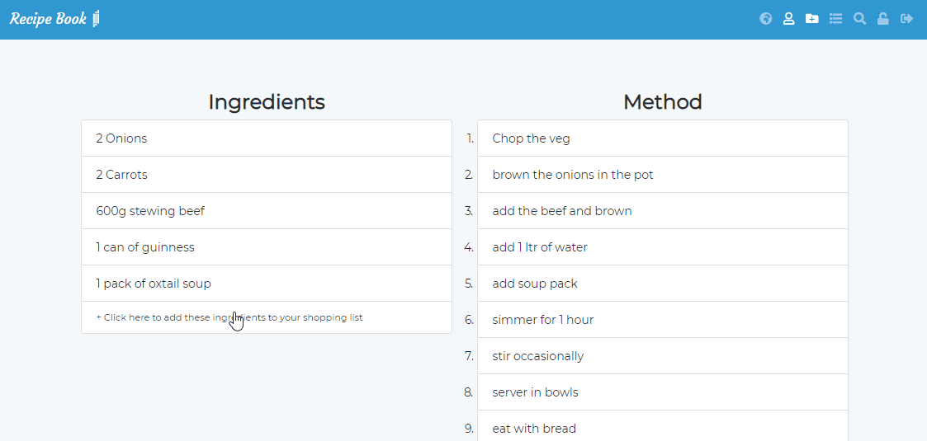
My recipe book
User Interface –Shopping List Page

Slide 11
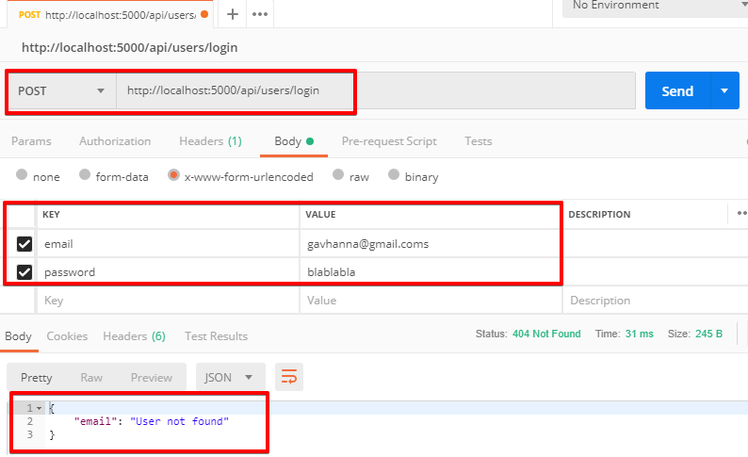
My recipe book
Testing - Server

Slide 12
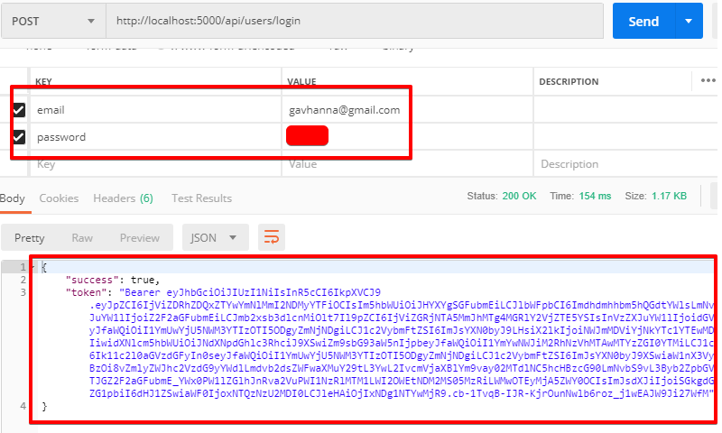
My recipe book
Testing - Server

Slide 13
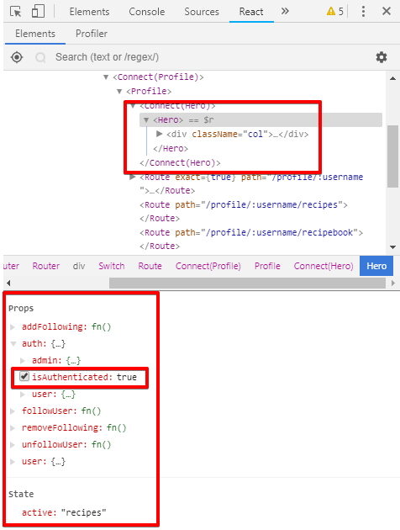
My recipe book
Testing – Client, React

Slide 14
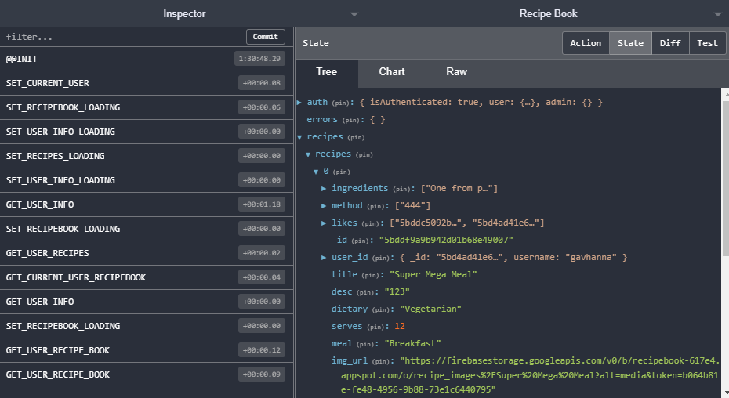
My recipe book
Testing – Client, Redux

Slide 15


My recipe book
Conclusion – Progressive Web Apps Pros and Cons

Slide 16

My recipe book
Further Development

Slide 17
My recipe book
The End
Questions?

